Slide 1
Arduino Uno R3
By
Devansh Srivastava
ISRO Intern, hG Joint Secretary, IEEE SB Chairman

Slide 2
Architecture of Atmega 328P
Low power CMOS 8-bit microprocessor based on RISC architecture and Harvard Architecture.
RISC Architecture- In this, the microprocessor has to load the data from the memory to the registers and then it can be used. It has less complexity and pipelining is possible. Number of clocks for each instruction is fixed.
Harvard Architecture- Program memory and Data Memory are kept in separate units. Due to this, parallel processing is possible.

Slide 3
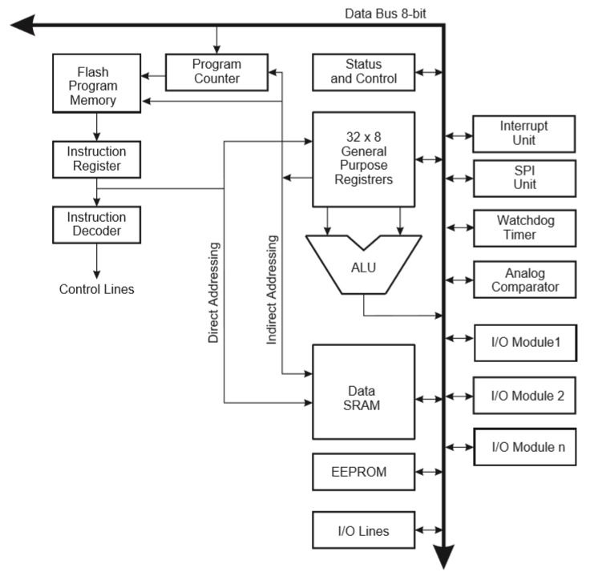
Architecture of ATmega 328P

Slide 4
Workflow of Atmega 328P
By the help of bootloader, the program is uploaded to the board. When uploaded, it is in HEX format, that is in form of 0 and 1.
The instruction is sent to instruction register bit-by-bit sequentially, and instantly to the decoder in the same clock.
After getting decoded, desired action is performed using the control signals. And the next instruction reaches the Instruction Register.

Slide 5
Components in Architecture
General Purpose Registers- It is used in storing the variables for calculations.
SRAM- It acts as backup RAM memory when all the registers are already used and more memory is needed for storing variables.
Flash Program Memory- We store our Arduino Sketch in this memory. It holds the instructions that we give to the microcontroller.
EEPROM- It is used to store the program that is intended to exist for a longer period of time.

Slide 6
Components in Architecture
Arithmetic Logical Unit(ALU)- It performs logical, arithmetic and bit operations.
Watchdog Timer- Whenever the microcontroller takes more time than expected, the watchdog timer resets the microprocessor.
Program Counter- It is a register that holds the address of the next instruction to be fetched.

Slide 7
Communication Interfaces

Slide 8
I2C- Inter Integrated Circuit Bus
Synchronous, Bi-directional, Half duplex two-wire Integrated Bus.
2 bus lines- Serial clock(SCL) and Serial Data(SDA)
Synchronous- Master and Slave has common clock
Half-Duplex- Only one end can transmit message at a time
Bi-directional- Data can be sent from both- master and slave

Slide 9
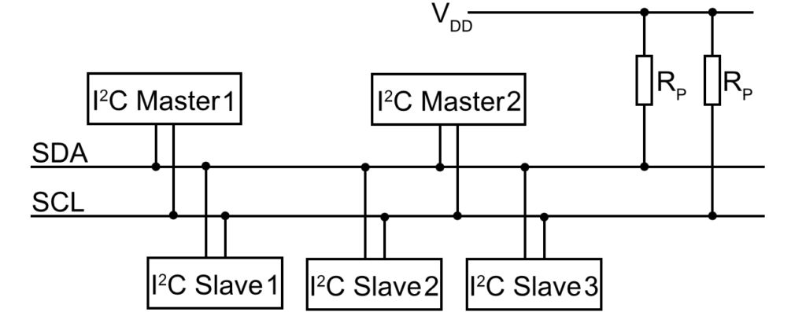
I2C

Slide 10
I2C- Inter Integrated Circuit Bus
Initially SCL and SDA is in HIGH condition. When the communication has to start, the MASTER makes the bus low.
MASTER sends the address of the slave to whom it wants to communicate. This address is checked by every slave and the destined SLAVE is identified.
After identification, MASTER sends either 1(Write) or 0(Read) to the Slave.
In return, the Slave will send an Acknowledgment and bus is ready for communication.

Slide 11
SPI- Serial Peripheral Interface
Synchronous, bi-Directional, Full duplex, four wire serial interface bus
Full-duplex- Both Slave and Master can send data at the same time
Single Master Multiple Slave
Four lines are- MISO(master in slave out), MOSI(master out slave in), SCLK(serial clock), SS(slave select)

Slide 12
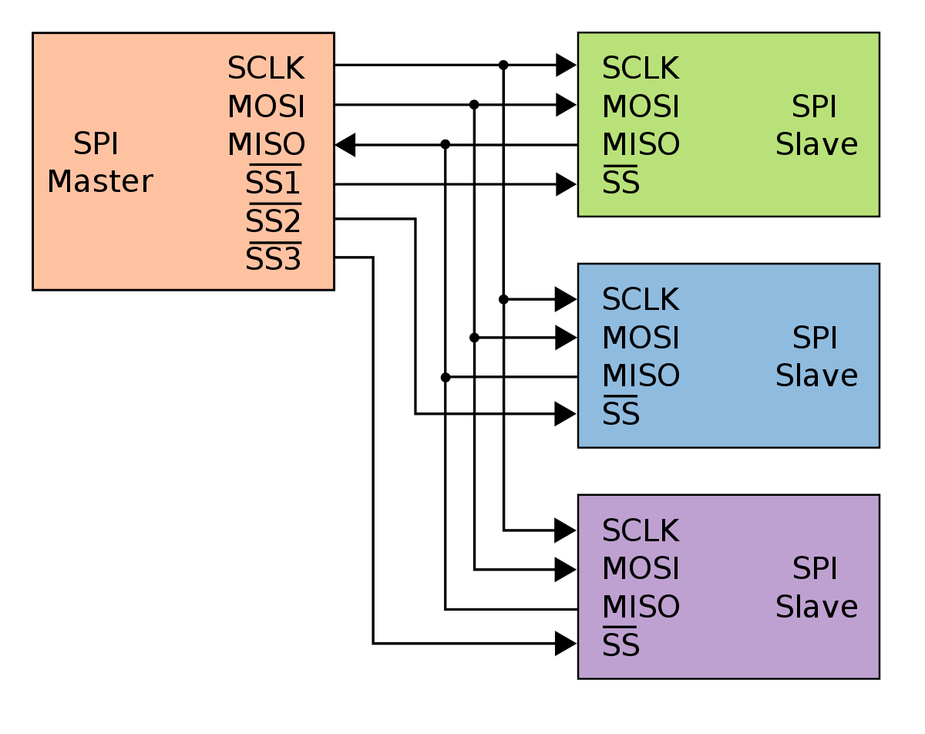
SPI- Serial Peripheral Interface

Slide 13
SPI- Serial Peripheral Interface
MISO- Slave send data to Master
MOSI- Master sends data to Slave
SS- SS in the master is used to enable the slave connected to it
SS in the slave decides whether slave has to listen to master or not. If SS in slave is low, It listens to the master.

Slide 14
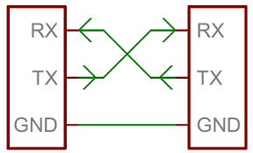
UART- Universal Asychronous Receiver Transmitter
Full duplex, asynchronous, three signal- Rx, Tx and CLK
Sender sends a starting bit and ending bit along with the message.

Slide 15
QnA

